Slide 1

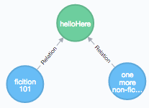

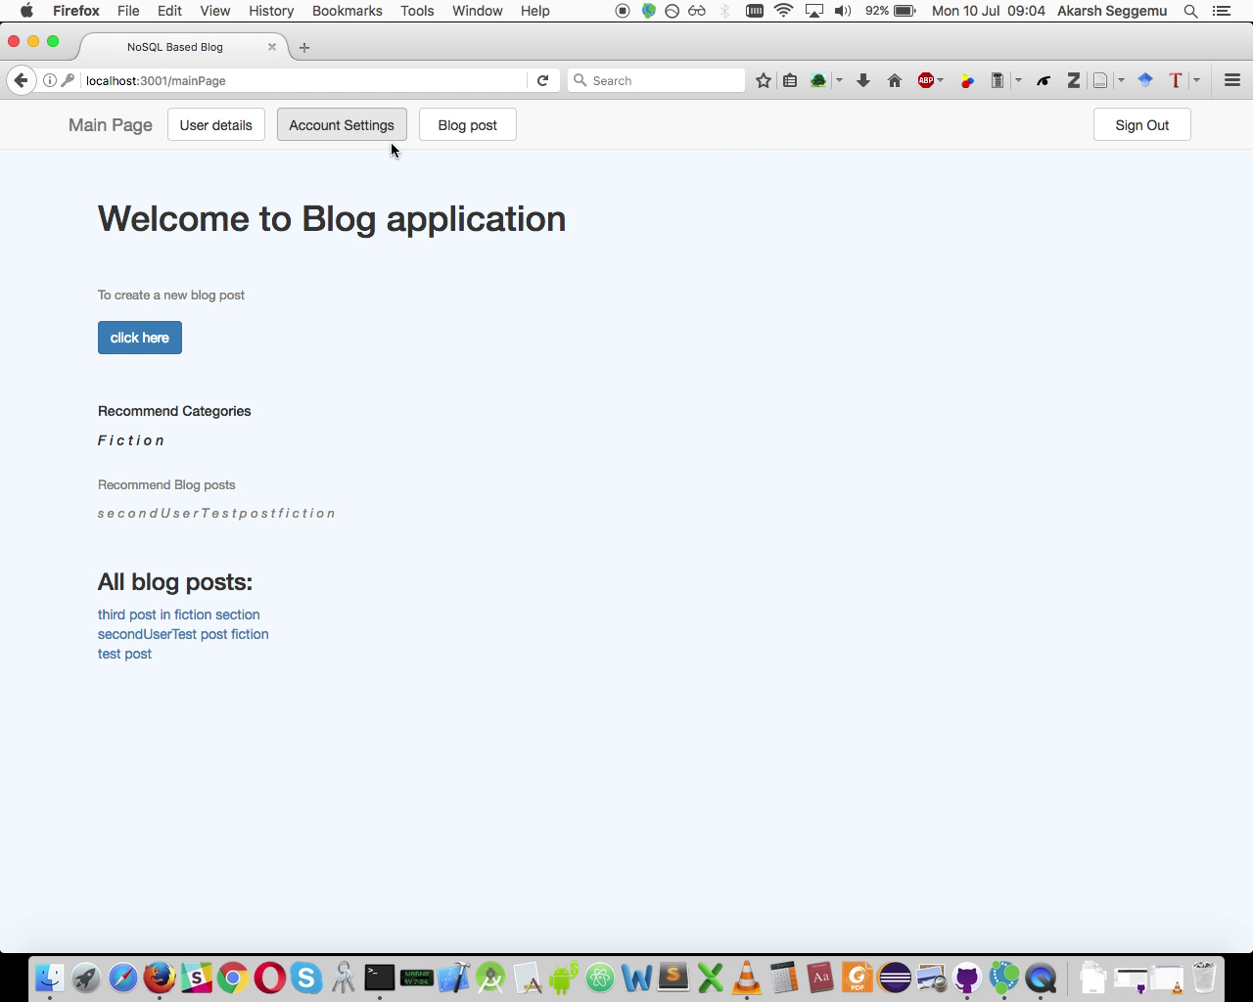
BLOG
NOSQL Databases (0423 L 777), SoSe 17
10.07.2017, Berlin
Akarsh Seggemu
Budankailu Sameer Kumar Subudhi Sonali Bhatnagar

Slide 2
Agenda
1.
Plan
2.
Databases
3.
Live demo

Slide 3
Plan
Task | Week no.
Kick-off meeting | Week 1
Literature research | Week 1, 2
Initial implementation | Week 2
Pitch presentation | Week 2
Reviews of initial implementation | Week 3
Final Implementation | Week 4,5
Final presentation | Week 6

Slide 4
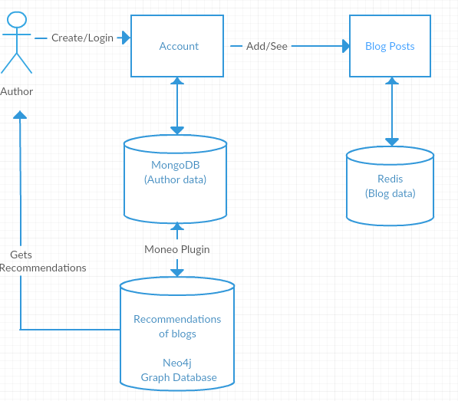
Application Architecture

Slide 5
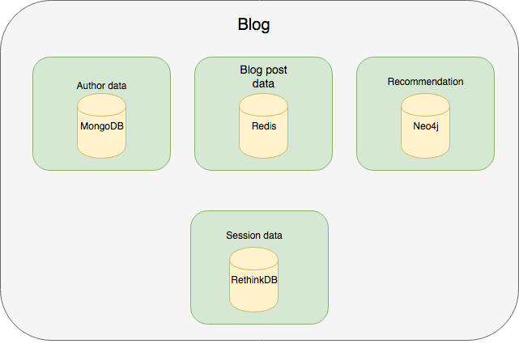
Databases: Architecture
MongoDB

Slide 6

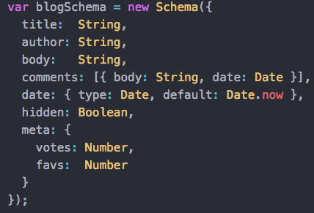

NOSQL Databses: MongoDB
Author data
ODM – Object Data Modelling

Slide 7

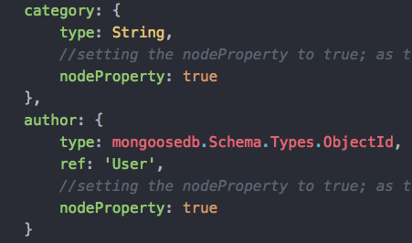
NOSQL Databses: moneo (plugin/middleware)
+ moneo =
Schema
Add nodeProperty: true
Add Schema.plugin(moneo)
Data Model

Slide 8

NOSQL Databses: Redis
Stores Blog Data: Blog Title,
Category,
Blog Content
Data is key-value pair with Key as Id and Value as Blog Data

Slide 9
Redis : Problems Encountered
Data can only be stored as key value pairs
(Blog Title, Content)
What if we wish to store more fields like Category, Username?
Solution : Store data in an array

Slide 10
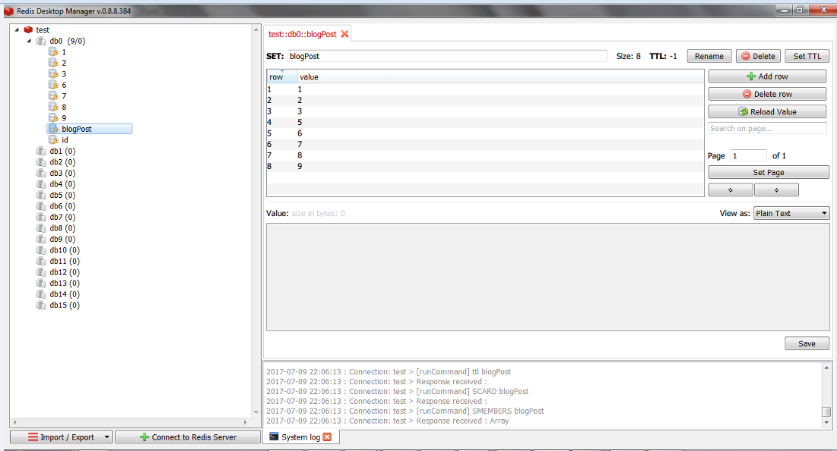
Redis Storage

Slide 11
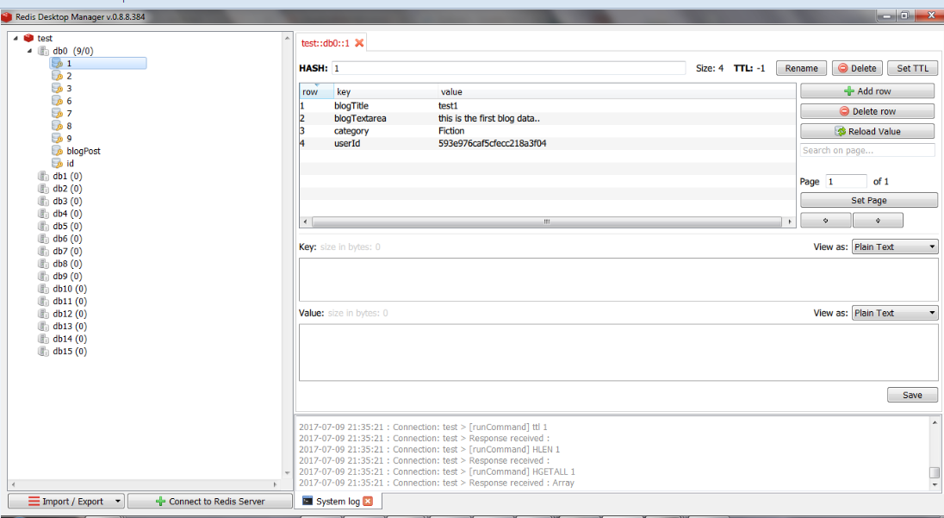
Redis Storage

Slide 12
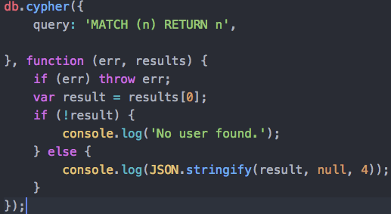
NOSQL Databses: Neo4j
Recommendation
Category
Blog posts
Node-Neo4j
Node.js driver for Neo4j via it’s REST API
Author
Fiction post
Non-fiction post

Slide 13

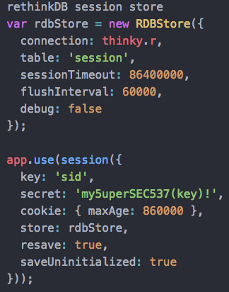

NOSQL Databses: RethinkDB
Session storage
Thinky
ORM – Object Relational mapping
express-session-rethinkdb
RethinkDB session store for Express 4.x

Slide 14

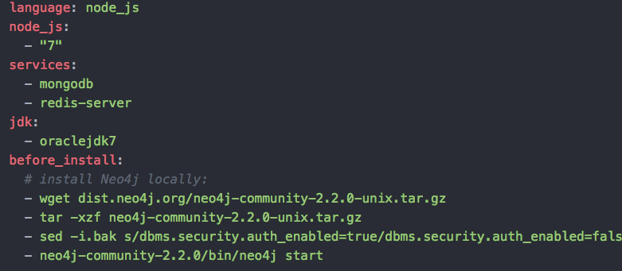
CI: Travis CI

Slide 15
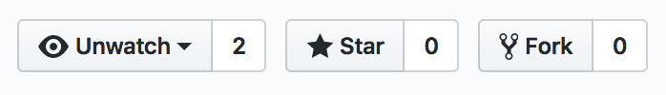
Live demo
https://github.com/akarsh/TUPJNOSQL17
Give us a star in github
Credits:
https://github.com/akarsh/TUPJNOSQL17#credits

Slide 16
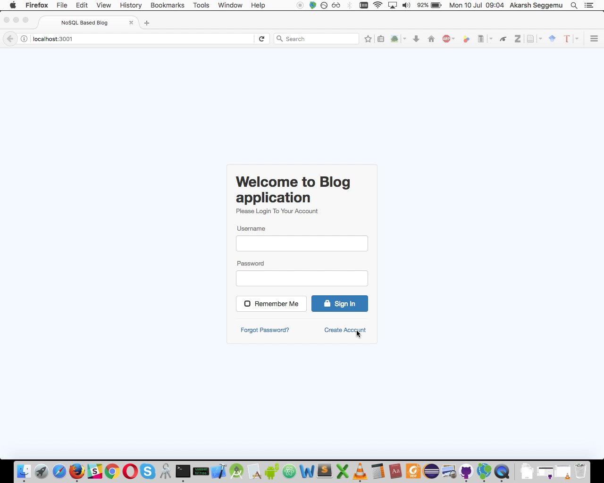

Slide 17
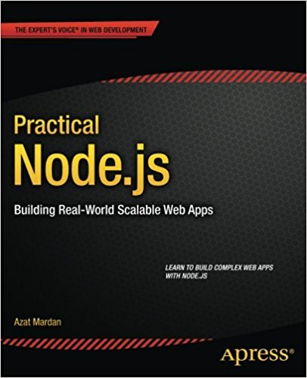

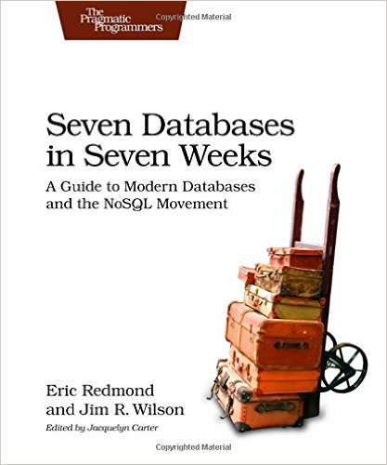

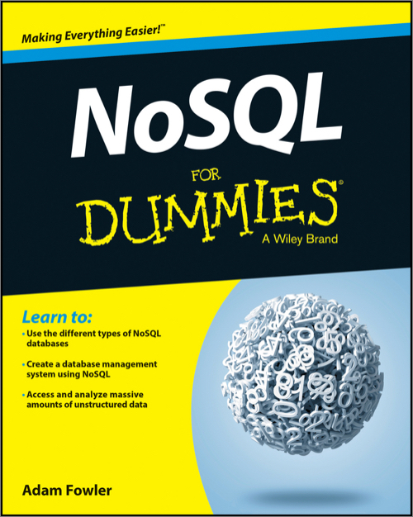
Literature
TUB - Library ST 250 J35 316
HUB - Library
ST 250 J35 B845
TUB – Library
ST 270 243
HTW - Library ST 270 S124
HUB – Library
ST 270 F785

Slide 18
Q & A ?
Thank you | Danke schön |
ధన్యవాదాలు

